Slide 1

CS375 Information Security
Lecture 8
Message Authentication & Hash Functions
Dr. Anwar Ghani
Lecturer
Department of Computer Science
International Islamic University, Islamabad
Email: anwar.ghani@iiu.edu.pk

Slide 2
Security Requirements
Disclosure
Traffic analysis
Masquerade
Content modification
Sequence modification
Timing modification
Source repudiation
Destination repudiation
Items 1 & 2 deal with confidentially
Items 3 – 6 deal with authentication
Items 7 & 8 deal with digital signature
Notes:
In the context of communications across a network, the attacks listed above can be identified.
The first two requirements belong in the realm of message confidentiality, and are handled using the encryption techniques already discussed.
The remaining requirements belong in the realm of message authentication. At its core this addresses the issue of ensuring that a message comes from the alleged source and has not been altered. It may also address sequencing and timeliness. The use of a digital signature can also address issues of repudiation by the source.

Slide 3
Message Authentication
Message authentication is concerned with
  protecting the integrity of a message
  validating identity of originator
  non-repudiation of origin (dispute resolution)
Three alternative functions used
  message encryption
  message authentication code (MAC)
  hash function
Notes:
Up untill now, have been concerned with protecting message content (ie secrecy) by encrypting the message. Will now consider how to protect message integrity (ie protection from modification), as well as confirming the identity of the sender. Generically this is the problem of message authentication, and in eCommerce applications is arguably more important than secrecy. Message Authentication is concerned with: protecting the integrity of a message, validating identity of originator, & non-repudiation of origin (dispute resolution). There are three types of functions that may be used to produce an authenticator: message encryption, message authentication code (MAC), or a hash function.

Slide 4
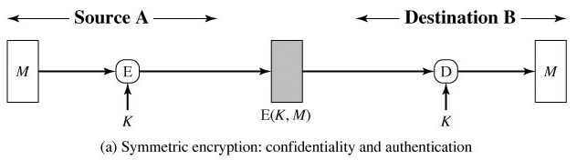
Message Encryption
Message encryption by itself provides a measure of authentication
Symmetric encryption is used
  receiver know sender must have created it
  since only sender and receiver know the key used
  know content cannot be altered
Notes:
Message encryption by itself can provide a measure of authentication. Here, the ciphertext of the entire message serves as its authenticator, on the basis that only those who know the appropriate keys could have validly encrypted the message. This is provided you can recognize a valid message (ie if the message has suitable structure such as redundancy or a checksum to detect any changes).

Slide 5
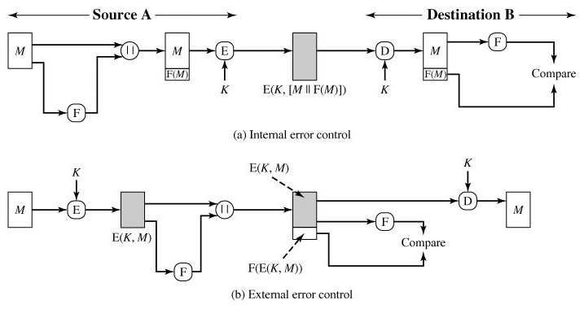
Message Encryption
Use of error control like FCS for message authentication
Two techniques
  internal error control
  External error control
Notes:
Message encryption by itself can provide a measure of authentication. Here, the ciphertext of the entire message serves as its authenticator, on the basis that only those who know the appropriate keys could have validly encrypted the message. This is provided you can recognize a valid message (ie if the message has suitable structure such as redundancy or a checksum to detect any changes).

Slide 6
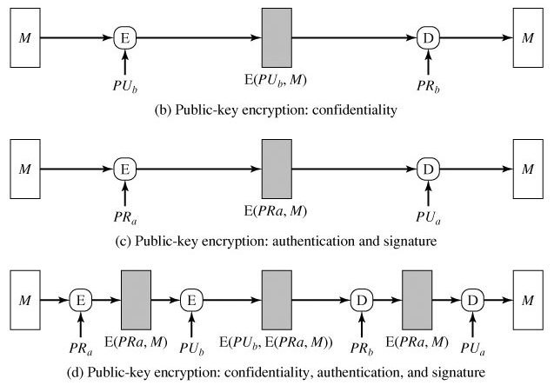
Message Encryption
If public-key encryption is used
  encryption provides no confidence of sender
  since anyone potentially knows public-key
  however, if sender signs message using his/her private-key
  then encrypts with recipients’ public key have both secrecy and authentication
  again, need to recognize corrupted messages
Notes:
With public-key techniques, can get a digital signature which can only have been created by key owner. But at cost of two public-key operations at each end on message.

Slide 7
Message Authentication Code (MAC)
MAC is generated by an algorithm that creates a small fixed-sized block
Appended to message as a signature
Receiver performs same computation on message and checks if it matches the MAC
Provides assurance that message is unaltered and comes from sender
MAC is a cryptographic checksum
  MAC = C_{K}(M)
  condenses a variable-length message M to a fixed-sized authenticator using a secret key K
It is a many-to-one function
  potentially many messages have same MAC
  but finding these needs to be very difficult
Notes:
An alternative authentication technique involves the use of a secret key to generate a small fixed-size block of data, known as a cryptographic checksum or MAC that is appended to the message. This technique assumes that two communicating parties, say A and B, share a common secret key K. A MAC function is similar to encryption, except that the MAC algorithm need not be reversible, as it must for decryption.

Slide 8
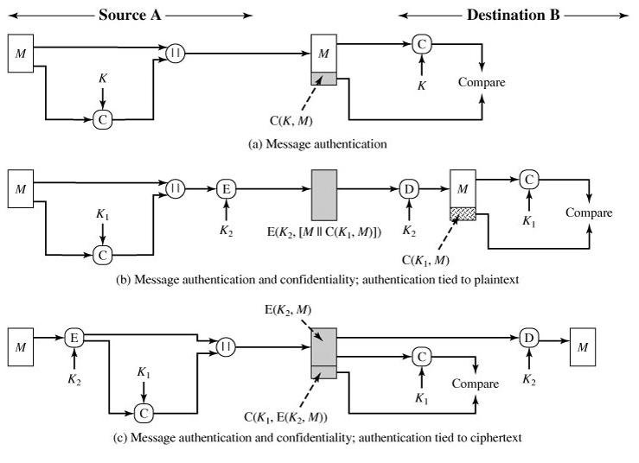
Message Authentication Code (MAC)
Notes:
An alternative authentication technique involves the use of a secret key to generate a small fixed-size block of data, known as a cryptographic checksum or MAC that is appended to the message. This technique assumes that two communicating parties, say A and B, share a common secret key K. A MAC function is similar to encryption, except that the MAC algorithm need not be reversible, as it must for decryption.

Slide 9
Message Authentication Code (MAC)
A → B: M||C(K, M)
  Provides authentication
  Only A and B share K
A → B:E(K2, [M||C(K1, M)])
  Provides authentication
  Only A and B share K1
  Provides confidentiality
  Only A and B share K2
A → B:E(K2, M)||C(K1, E(K2, M))
  Provides authentication using K1
  Provides confidentiality using K2
Notes:
An alternative authentication technique involves the use of a secret key to generate a small fixed-size block of data, known as a cryptographic checksum or MAC that is appended to the message. This technique assumes that two communicating parties, say A and B, share a common secret key K. A MAC function is similar to encryption, except that the MAC algorithm need not be reversible, as it must for decryption.

Slide 10
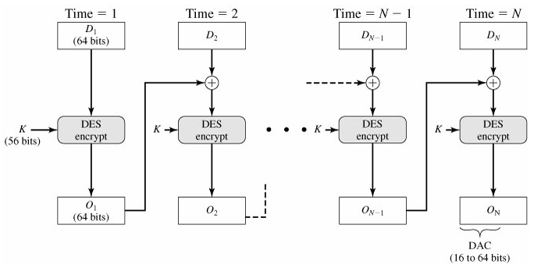
MAC Based on DES
Can use any block cipher chaining mode and use final block as a MAC
Data Authentication Algorithm (DAA) is a widely used MAC based on DES-CBC
  using IV=0 and zero-pad of final block
  encrypt message using DES in CBC mode
  and send just the final block as the MAC
Notes:
Can also use block cipher chaining modes to create a separate authenticator, by just sending the last block. This was done with the Data Authentication Algorithm (DAA), a widely used MAC based on DES-CBC (next slide). However this suffers from being too small for acceptable use today.

Slide 11
Hash Functions
Condenses arbitrary message to fixed size
  h = H(M)
Usually assume that the hash function is public and not keyed
Hash used to detect changes to message
Can use in various ways with message
Most often to create a digital signature
A → B:E(K, [M||H(M)])
A → B: M||E(K, H(M))
A → B: M||E(PRa, H(M))
A → B: E(K, [M||E(PRa, H(M))])
A → B: M||H(M||S)
A → B: E(K, [M||H(M||S])
Notes:
A variation on the message authentication code is the one-way hash function. As with the message authentication code, a hash function accepts a variable-size message M as input and produces a fixed-size output, referred to as a hash code H(M). Unlike a MAC, a hash code does not use a key but is a function only of the input message. The hash code is also referred to as a message digest or hash value.

Slide 12
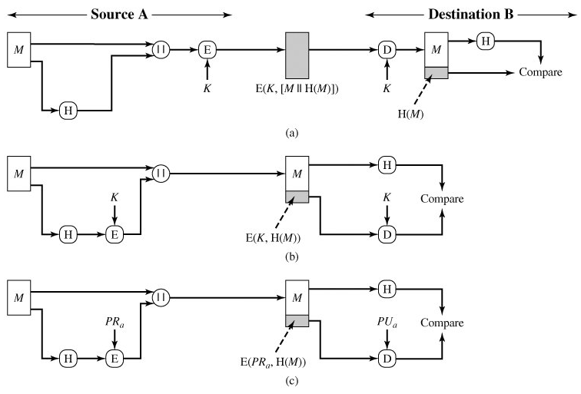
Hash Functions
Notes:
A variation on the message authentication code is the one-way hash function. As with the message authentication code, a hash function accepts a variable-size message M as input and produces a fixed-size output, referred to as a hash code H(M). Unlike a MAC, a hash code does not use a key but is a function only of the input message. The hash code is also referred to as a message digest or hash value.

Slide 13
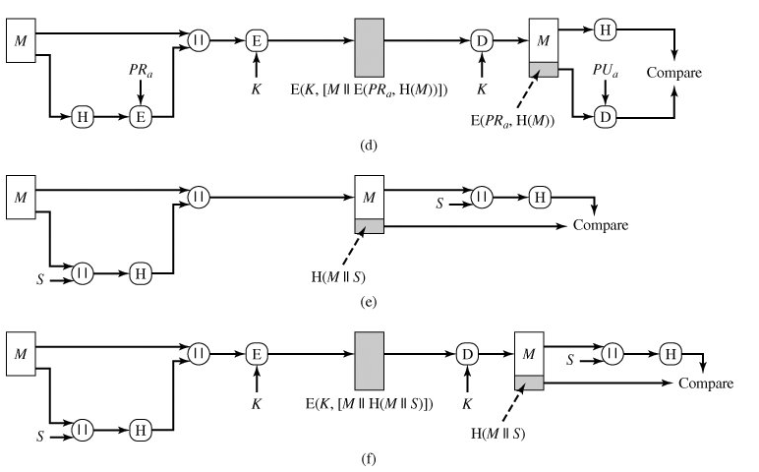
Hash Functions
Notes:
A variation on the message authentication code is the one-way hash function. As with the message authentication code, a hash function accepts a variable-size message M as input and produces a fixed-size output, referred to as a hash code H(M). Unlike a MAC, a hash code does not use a key but is a function only of the input message. The hash code is also referred to as a message digest or hash value.

Slide 14
Requirements for Hash Functions
H can be applied to block of data of any size M
Produces fixed-length output h
Easy to compute h=H(M) for any message M
For any value of h, it is computationally infeasible to find x such that H(x)=h
  one-way property
For any given block x, it is computationally infeasible to find y such that H(y)=H(x)
  weak collision resistance
It is computationally infeasible to find any pair (x,y) such that H(y)=H(x)
  strong collision resistance
Notes:
The purpose of a hash function is to produce a “fingerprint”of a file, message, or other block of data.
These are the specifications for good hash functions. Essentially it must be extremely difficult to find 2 messages with the same hash, and the hash should not be related to the message in any obvious way (ie it should be a complex non-linear function of the message). There are quite a few similarities in the evolution of hash functions & block ciphers, and in the evolution of the design requirements on both.

Slide 15
Simple Hash Functions
Simple hash functions based on XOR of message blocks
Simplest hash functions is calculated bit-by-bit exclusive-OR (XOR) of every block expressed as follows:
  Ci = b_{i1} b_{i2} ... b_{im}
  Where Ci = ith bit of the hash code, 1 < i < n
  m = number of n-bit blocks in the input
  bij = ith bit in jth block
Notes:
All hash functions operate using the following general principles. The input (message, file,etc.) is viewed as a sequence of n-bit blocks, processed one block at a time in an iterative fashion to produce an n-bit hash function. Can construct a range of possible simple hash functions by just XOR’ing blocks with rotates etc. None of these are secure, since can predict how changes to message affect the resulting hash.

Slide 16
Block Ciphers as Hash Functions
Can use block ciphers as hash functions
  using H₀=0 and zero-pad of final block
  compute: H_{i} = E_{Mi} [H_{i-1}]
  and use final block as the hash value
  similar to CBC but without a key
Resulting hash is too small (64-bit)
  both due to direct birthday attack
  and to “meet-in-the-middle” attack
other variants also susceptible to attack
Notes:
A number of proposals have been made for hash functions based on using a cipher block chaining technique, but without the secret key (instead using the message blocks as keys). Unfortunately these are subject to both the birthday attack, and to a “meet-in-the-middle” attack. Thus, attention has been directed at finding other approaches to hashing.

Slide 17
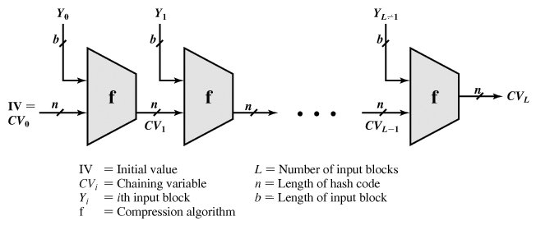
Secure Hash Function/Code
The overall structure of a typical secure hash function is referred to as an iterated hash function
The most hash functions like SHA in use today, is based on this structure
The hash function takes an input message and partitions it into L fixed-sized blocks of b bits each
If necessary, the final block is padded to b bits
The final block also includes the value of the total length of the input to the hash function
Notes:
A number of proposals have been made for hash functions based on using a cipher block chaining technique, but without the secret key (instead using the message blocks as keys). Unfortunately these are subject to both the birthday attack, and to a “meet-in-the-middle” attack. Thus, attention has been directed at finding other approaches to hashing.

